Slide 1
CPU SCHEDULING WITH C++
CSC 333 - OPERATING SYSTEM
PRESENTATION BY GROUP 2

Slide 2
WHAT IS CPU SCHEDULING?
CPU scheduling is an important feature of operating systems that determines the order in which processes are executed by the Central Processing Unit (CPU).
The goal of CPU scheduling is to optimise the utilisation of the CPU and enhance system performance.

Slide 3
TYPES OF CPU SCHEDULING
First Come, First Served Scheduling (FCFS)
Shortest Job First Scheduling (SJF)
Priority Scheduling
Round Robin Scheduling (RR)
Multilevel Queue Scheduling
Multilevel Feedback Queue Scheduling

Slide 4
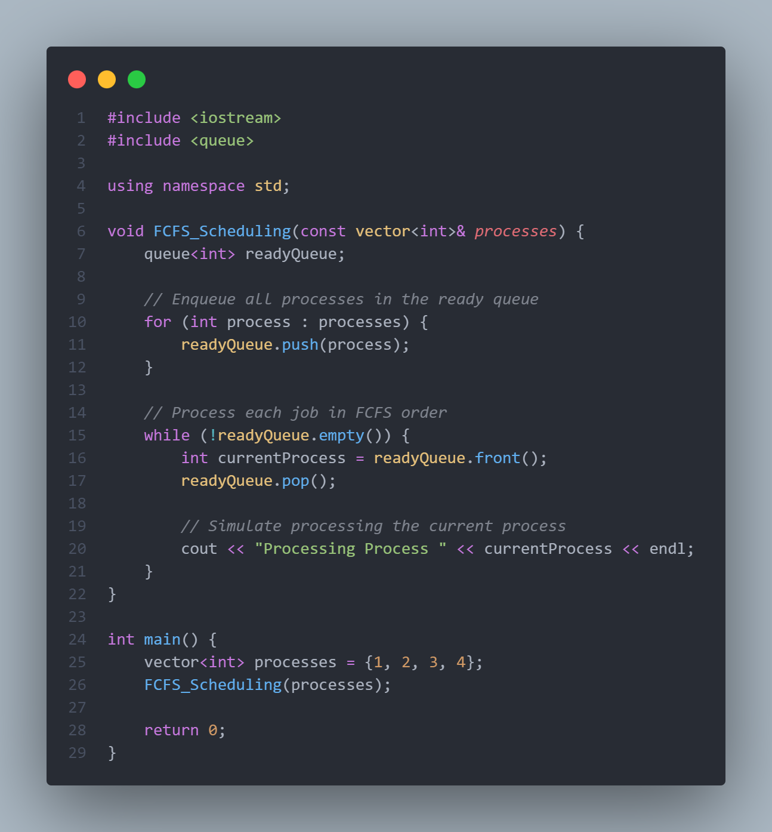
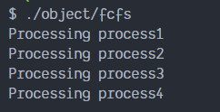
FIRST COME, FIRST SERVED SCHEDULING

Slide 5
FIRST COME, FIRST SERVED SCHEDULING
Advantage:
Simple and easy to implement
Drawback:
Can lead to “CONVOY” effect, where short processes get stuck waiting behind a long process.
Can lead to inefficient use of CPU time, especially in the presence of long processes.

Slide 6
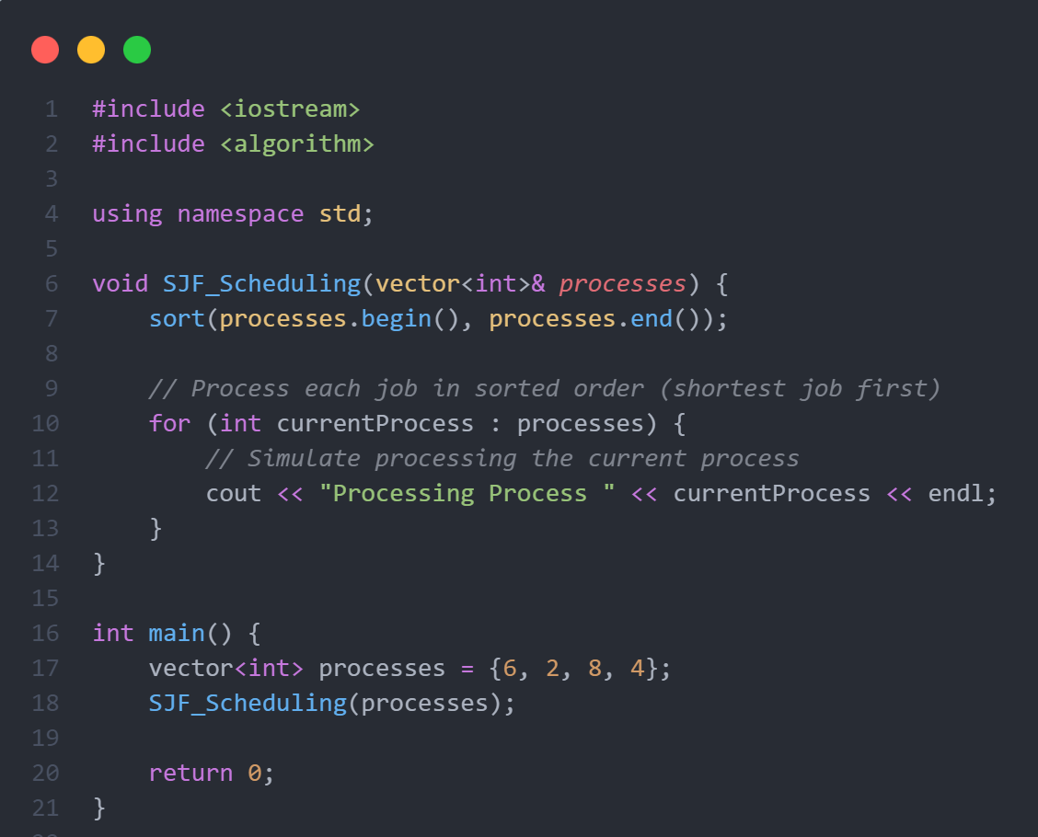
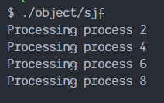
SHORTEST JOB FIRST SCHEDULING

Slide 7
SHORTEST JOB FIRST SCHEDULING
Advantage:
Minimises waiting time and provides optimal throughput for a set of processes.
Drawback:
Requires knowledge of the total burst time, which is often not available in a real-time environment.

Slide 8
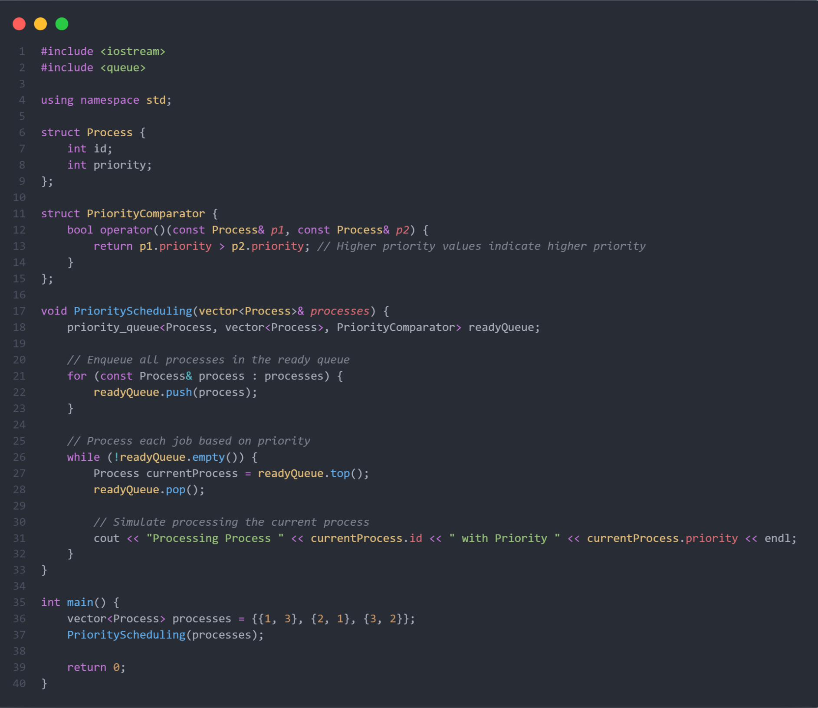
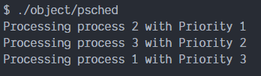
PRIORITY SCHEDULING

Slide 9
PRIORITY SCHEDULING
Advantage:
Allows assigning priority levels to processes based on various factors.
Drawback:
Can lead to starvation of low-priority processes if not implemented carefully.

Slide 10
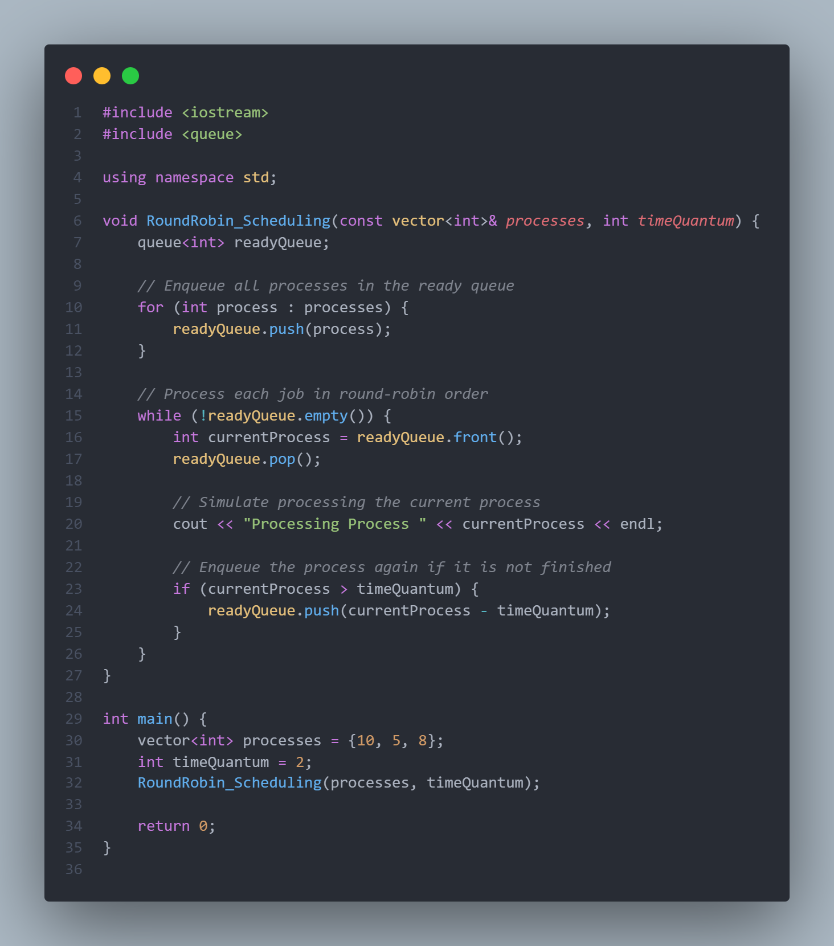
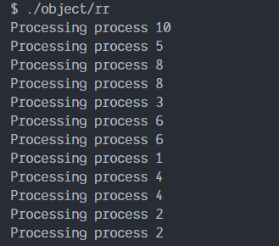
ROUND ROBIN SCHEDULING

Slide 11
ROUND ROBIN SCHEDULING
Advantage:
Fairness in terms of process execution; all processes get an equal share of the CPU.
Drawback:
High turnaround time for long processes, and the time quantum needs careful tuning.

Slide 12
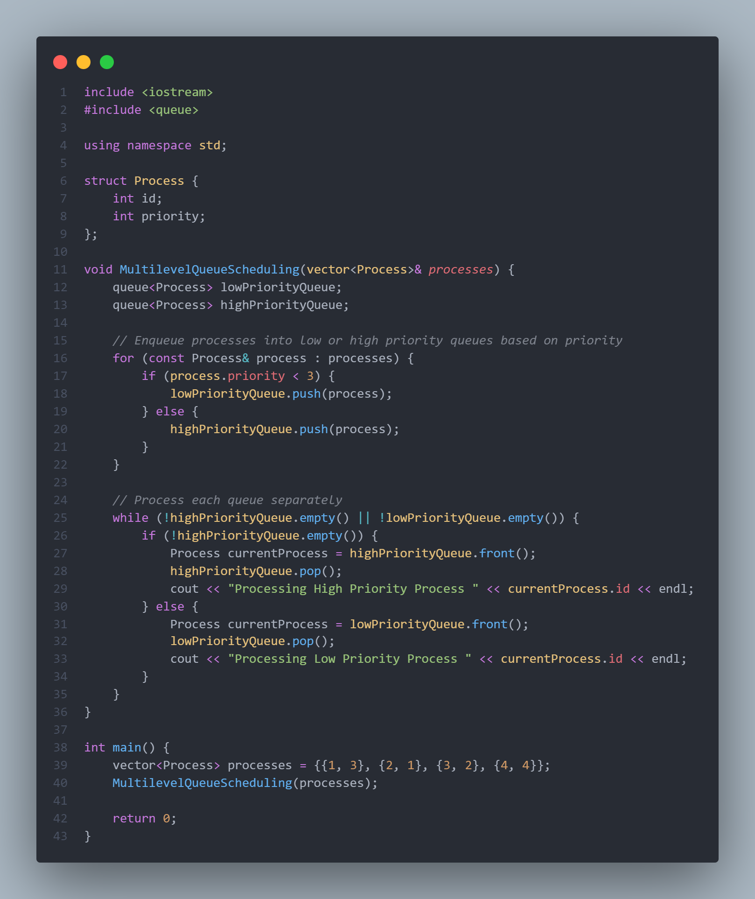
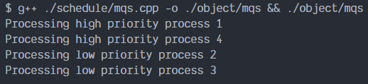
MULTILEVEL QUEUE SCHEDULING

Slide 13
MULTILEVEL QUEUE SCHEDULING
Advantage:
Supports the division of processes into different priority levels, each with its own scheduling algorithm.
Drawback:
Complexity in managing multiple queues.

Slide 14
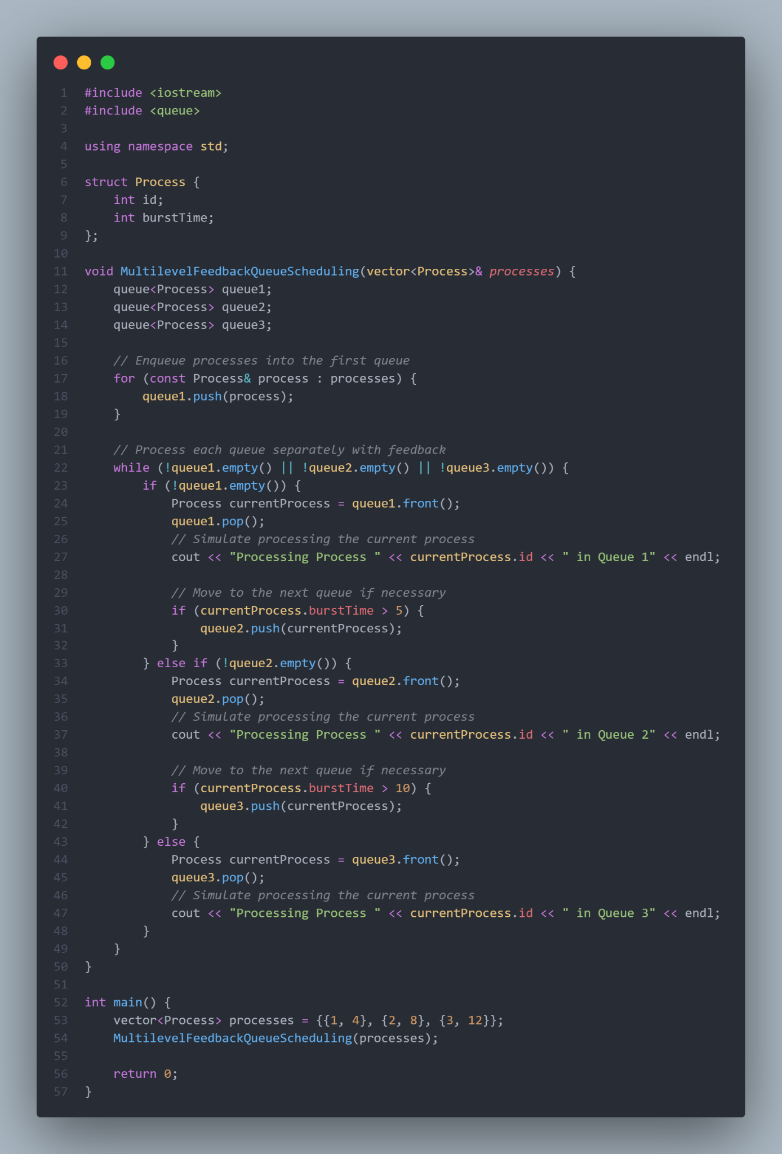
MULTILEVEL FEEDBACK QUEUE SCHEDULING

Slide 15
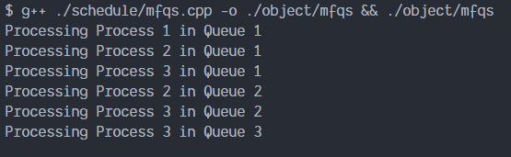
MULTILEVEL FEEDBACK QUEUE SCHEDULING
Advantage:
Allows processes to move between different priority queues based on their behaviour.
Drawback:
Requires careful tuning of parameters to prevent processes from oscillating between queues.

Slide 16
THANK YOU

